Slide 1
CTS2 Development Framework Implementation Technical Overview
Scott Bauer, Cory Endle
HL7 Working Group Meeting
January 13th -18th, 2013

Slide 2
Pre-tutorial House Keeping
This tutorial is not in a computer lab
If you wish to follow along with the interactive demos you’ll need a laptop and the tech stack and set up noted in the requirements document
This will need to be done before the tutorial starts if you want to follow along
Instructions are in the requirements document here:https://github.com/hsbauer/cts2-example-service/archive/master.zip

Slide 3
Who is this Tutorial for?
Software developers, technical programmers, Information architects, health informaticists, technical analysts
Should know how to implement the CTS2 technical framework specification at the end of this tutorial

Slide 4
What do I Need to Know as a Developer
Introduction to CTS2 recommended
Some knowledge of UML, CTS2 Specification, XML, JSON, REST required for full implementation
Java and JavaScript will be helpful for some of the example
Command line Maven, Python and Unix/Linux may be helpful as well

Slide 5
Overview
CTS2 is an OMG standard for the query, interchange and update of terminological resources.
This tutorial will provide technical implementers with guidance for the implementation of the standard.

Slide 6
Terminology Services
Terminologies:
A list of unique terms and a set of properties helps define our common context for a term.
Like a dictionary.
The way we know how to use terms is more complex:
Classifications
Synonyms
Unstated relationships

Slide 7
Terminology Services
Knowing what is not in a dictionary is a way of knowing (This is sometimes called ontology).
This is often built in to complex terminologies
A terminology service provides the structure
For using this way of knowing about the service
For dealing with updates, versioning, history and other administrative functions

Slide 8
How to Approach the Specification
The specification is designed for modular implementation. You do not need to implement the entire specification!
Choose your implementation strategy based on local requirements, not to include a broad spectrum of the specification

Slide 9
Modular Specification Implement / use what you need
Code System Catalog Entry and Code System Version Catalog Entry
Entity Description and Association
Value Set Catalog, Value Set Definition and Resolved Value Set
Map Catalog Entry, Map Version
Concept Domain, Concept Domain Binding
Statement

Slide 10
Modular Functionality Implement / use what you need
Read
Query
Import
Export
Update
Maintenance
History
Temporal
Notes:
Read: Read a specifically identified elements contents
Query: Query given particular parameters, restrictions, search algorithms. Includes the ability to import or export content.
Update: the ability to validate load sets of changes into the service that updates its content
History – the ability to determine what changes have occurred over stated periods of time
Maintenance – the ability to create and commit sets of changes (May include deletes)
Temporal – the ability to ask questions about the state of the service at a given point in the past (or future).

Slide 11
Every Module Has:
Formal Information Model in UML
Defines the resource, how it is identified and what information it contains
Formal Computational Model in UML
Defines operations that are available for each functional (read, query, import, …) profile

Slide 12
Every Module Also Has
XML Schema representation of the Information Model
WADL rendering of Computational Model
Defines the URLs + operations (GET, PUT, POST, REMOVE) that implement the computations
WSDL rendering of Computational Model

Slide 13
Combined they provide a set of rules that:
Describe (some of) what can be said about various aspects of terminologies
Provide a straight-forward format for structuring the information
Provide rules for publishing, querying, exchanging and updating information in a distributed, federated environment

Slide 14
CTS2 in a nutshell
A set of XML Schemas for:
Code Systems, Maps, Value Sets and Concept Domain Bindings
A set of URL formation rules for:
Reading, Querying, Importing and Updating the XML Documents
A set of rules for representing XML in JSON, RDF, Java, Python, …

Slide 15
CTS2 Implementation Planning an Implementation

Slide 16
How do I plan an implementation?
Ask the following questions:
Do I need to implement a terminology service of my own?
Do I need unique content?
Do I need unique services from the content?
Can I adequately map the content into the CTS2 Model or do I need expert help?

Slide 17
How do I plan an implementation? CTS2 Service
A persisted Terminology
CTS2 doesn’t specify how this is done
It may require wrapping an existing terminology service
Providing a mapping and a bridge for legacy technology
Or creating a direct implementation of CTS2 over a database
Starting from scratch against a (set of) persisted terminologies.

Slide 18
How do I plan an implementation? Are You Consuming Terminology Content?
If so what services do I need from the terminology service:
Do I want to search for terminology entities?
Do I need value sets for research forms?
Do I need to map from one terminology to another?
Do I need to traverse from a specific term to a more general one. Or establish term classification siblings? Semantic types?

Slide 19
Ways to Implement
Service Implementers may want to implement a CTS2 Development Framework (DF) service plugin (This isn’t required.)
CTS2 consumers will want to implement a REST/JSON, REST/XML or SOAP client
Notes:
References for cts2 informatics, rest api, and development framework

Slide 20
CTS2 Plugin Tutorial Overview

Slide 21
Plugin Tutorial Overview Where to Start
We’ll choose a CTS2 module that can serve a fairly wide set of use cases:
CodeSystemCatalogEntry
Create a service plugin based on this model element
And use the same model element to access code system entities, their associated children, value sets, and versions of code systems.
Note that this is a very small part of the API

Slide 22
CTS2 Development Framework Providing a Toolset
REST HTTP URL bindings
CTS2 model as Java Beans
Various Builder pattern query building objects
CTS2 REST client
Manages JSON and XML parsing and Marshaling of either into CTS2 model objects
Plugin admin structure
A quick start on your own service

Slide 23
CTS2 Implementation Service Plugin Tutorial

Slide 24
CTS2 Plugins How are Development Framework Plugins Used?
A plugin can be used to add a service to the CTS2 Development Framework base.
Given a source terminology with it’s own data model and corresponding database schema
Map it into a set of CTS2 Model Objects and attach it to the framework where it can be served up in CTS2 REST
Notes:
What’s an example of a plugin.

Slide 25
CTS2 plugins How are Plugins Used?
How can a plugin be enabled within the CTS2 Development Framework?
Every plugin must implement the ServiceProvider Interface*
The jarred plugin will be uploaded to the stand alone CTS2 Development Framework server.
*edu.mayo.cts2.framework.service.provider.ServiceProvider
Notes:
How is OSGI used here?

Slide 26
CTS2 Development Framework Service Plugin Example Requirements
Maven
Eclipse with the Maven plugin
Example Code
Stand alone CTS2 Framework Server
MySQL loaded with small Gene Ontology database

Slide 27
CTS2 Development Framework Service Plugin Example Goals for this part of tutorial
Connect to a service
Integrate 3rd party software into the build
Map source data to a CTS2 model element
Get the standalone development framework service up and running
Integrate the plugin into the service

Slide 28
Interactive Demo Service Plugin
If you want to follow along, you should at this point have:
Maven installed
MySQL server started with the Gene Ontology loaded into a database named “godata”
The example project pulled into Eclipse
The code snippet folder available
Initial clean and install of the maven build
Instructions here: https://github.com/hsbauer/cts2-example-service/archive/master.zip

Slide 29
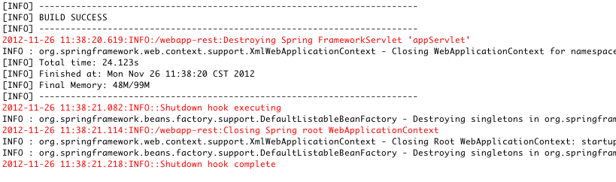
Interactive Demo Service Plugin
After running the clean install command your output should look something like this:
Notes:
Right click on the project folder and choose Maven => Clean
When complete, right click again and choose Maven => Install

Slide 30
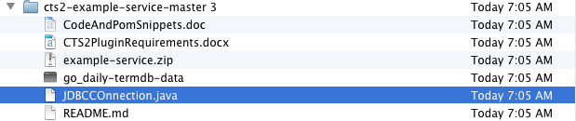
Interactive Demo Service Plugin
Connecting to a unique source.
Copy the JDBConnnector.java file to the edu.mayo.cts2.framework.plugin.service.example folder of the example-service
Notes:
From the cts2-example-service/example service zip, get the JDBCConnection.java file and place it in the source folder.

Slide 31
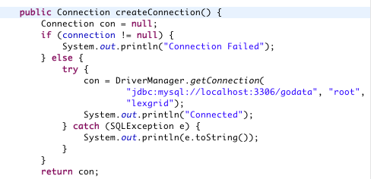
Interactive Demo Service Plugin
Adjust the hard coded connection properties to your local MySQL installation.
Notes:
Name, password and URL should reflect local settings.

Slide 32
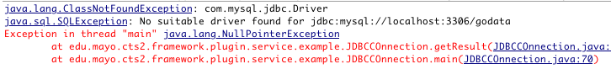
Interactive Demo Service Plugin
Running the main method we see we need a JDBC driver class.
Notes:
If you run the main class here it will fail. Pull in a connector with adjustments to the pom file.

Slide 33
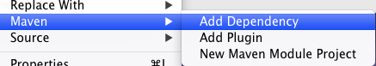
Interactive Demo Service Plugin
Using Eclipse as our example we’ll add a dependency to the pom.xml file:
Notes:
Right click on the project and choose Maven => Add Dependency

Slide 34
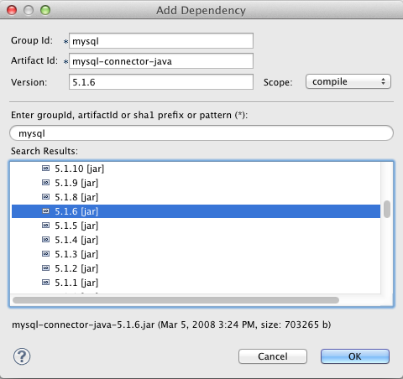
Interactive Demo Service Plugin
Add the MySQL connector version 5.1.6 to the pom file:
Notes:
Type mysql into the Enter group id field and the dependency wizard will automatically search for mysql related dependencies. Scroll down to the mysql-connector-java and open the folder to expose all available versions. Choose 5.1.6 and press OK.

Slide 35
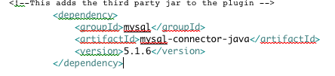
Interactive Demo Service Plugin
Alternatively you can cut and paste from the CodeAndPomSnippets file:
Notes:
Cut and paste into the the <dependencies> tag

Slide 36
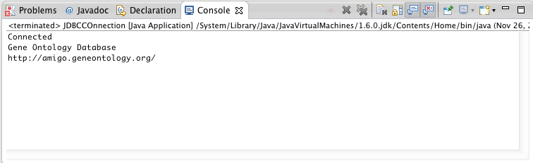
Interactive Demo Service Plugin
Running the main method against the “godata” database should give you output like this:
Notes:
Run the main class in the JDBC connector again and it should give you metadata about the GO ontology.

Slide 37
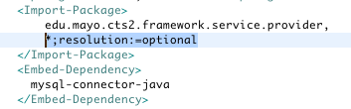
Interactive Demo Service Plugin
This gives us local runtime access to the connector – Let’s add it to the build using the OSGI bundling plugin (maven-bundle-plugin) and leave the other dependencies unresolved. We do this by adding it to the pom file:
Notes:
Now we want to add this to the build.
Using additions to the pom file we'll add the connector to a maven build.
Update this inside the instructions tag
Save the pom file and do a clean install sequence

Slide 38
Interactive Demo Service Plugin
The current mapping of the CTS2 CodeSystemCatalogEntry object is hardcoded
Change that to a dynamic method:
Copy and paste over the entire read method with the snippet from the CodeAndPomSnippet’s file
This runs a query against the database depending upon the abbreviated name of a code system
Run the Maven clean and install methods

Slide 39

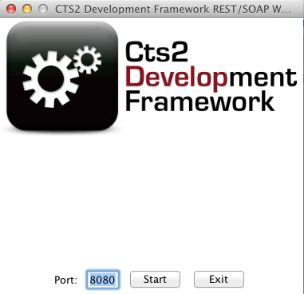
Interactive Demo Service Plugin
Start the standalone server:
Notes:
From whatever directory you choose to install the cts2 framework standalone server start the service by executing the jar file from java, then pushing the start button.

Slide 40
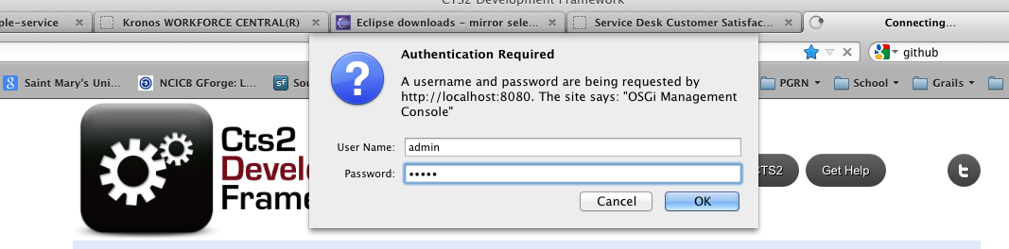
Interactive Demo Service Plugin
Click on the Admin Console button on the resulting web page:
Login using admin/admin.
Notes:
And login as admin/admin

Slide 41
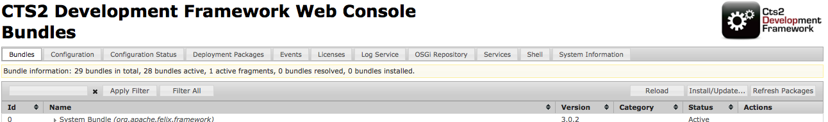
Interactive Demo: Service Plugin Import Plugin to Framework
Click on install/update
Notes:
Choose install update from the bar at the top of the list of plugins.

Slide 42
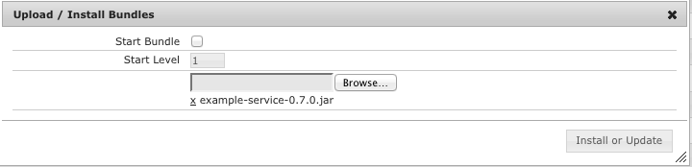
Interactive Demo: Service Plugin Import Plugin to Framework
Upload the jar
Notes:
Browse to the jar constructed in the maven build target folder

Slide 43
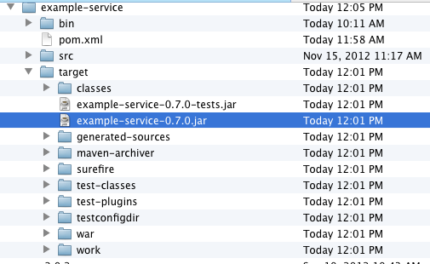
Interactive Demo: Service Plugin Import Plugin to Framework

Slide 44

Interactive Demo: Service Plugin Import Plugin to Framework
If necessary start the plugin:
Notes:
Refresh the browser
Click the play/stop button next to the example service plugin.

Slide 45

Interactive Demo: Service Plugin Import Plugin to Framework
Create a REST call in a browser address bar:
Notes:
Type localhost:8080/codesystem/GO

Slide 46
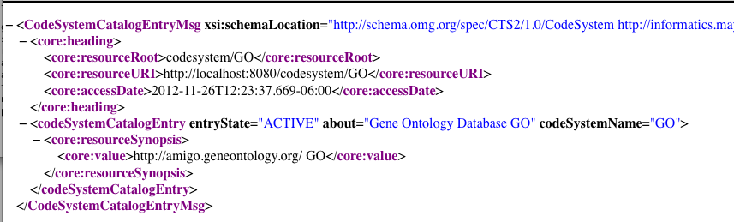
Interactive Demo Service Plugin
Expected Results

Slide 47
Interactive Demo Service Plugin
What have we learned:
What class needs to be extended to create a plugin class
How to create a mapping from a source to a CTS2 compatible element
How to import third party software into the OSGI bundling system using maven
How to run the CTS2 Development Framework Standalone server and upload a plugin to it

Slide 48
CTS2 REST API

Slide 49
CTS2 REST API
CTS2 is designed on a REST architecture:
This shapes method calls and naming conventions
A directory is a summary of a group of objects, such as code systems or entities. A catalog (list) will provide complete objects
Read services generally are looking for a unique identifier for input
Query services offer filters on a matching value

Slide 50
Interactive Demo: CTS2 REST API
The focus will be on read and query module functions
Entity, code system(s), code system versions and value sets to comprise the examples
REST calls will be to the NCBO Bioportal CTS2 REST wrapper

Slide 51
CTS2 REST API
How do we know what systems are at a service?
Start by querying the code systems
http://informatics.mayo.edu/cts2/rest/codesystems
This returns a directory, or list of summaries of the code systems on that service

Slide 52
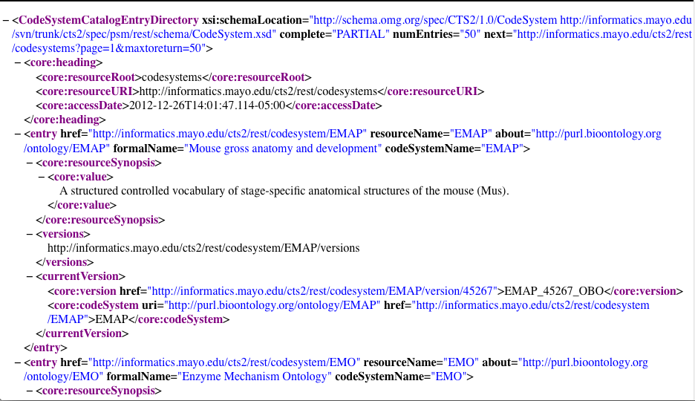

Slide 53
CTS2 REST API
How can we query individual code systems from this service?
Working through CodeSystem and CodeSystems REST APIs
By name, ontologyId, or description
By matching algorithms “contains” or “exact match”

Slide 54
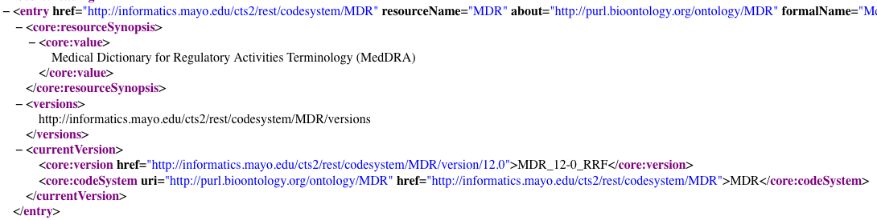
CTS2 REST API
Searchable fields in the CodeSystemDirectoryEntry

Slide 55
CTS2 REST API
Working through codesystems, name is matched against the abbreviated ontology designation.
Example: MedDRA is MDR.
http://informatics.mayo.edu/cts2/rest/codesystems?matchvalue=MDR&filtercomponent=resourceName
Where matchvalue is the text to match and resourceName is the name field to match
Notes:
Add some screen shots

Slide 56
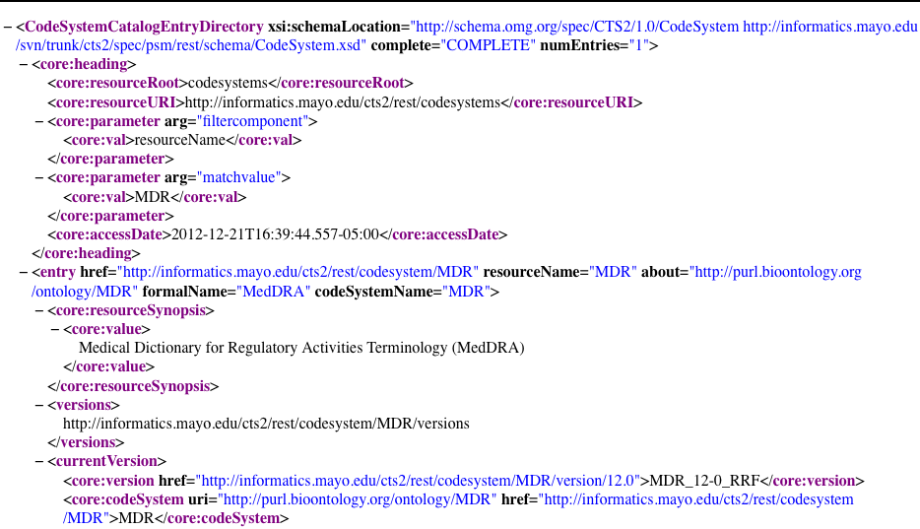

Slide 57
CTS2 REST API
Using the codesystems API, the other “filtercomponents” we can match are:
resourceSynopsis: a description of the resource
resourceName: the abbreviation of the code system
about: the URI of the code system
keyword: contents of the keyword tag
ontologyId: unique ID of the ontology in the service

Slide 58
CTS2 REST API
Direct read calls to the code system API require a a similar knowledge of the abbreviated name of the code system:
http://informatics.mayo.edu/cts2/rest/codesystem/VANDF
You can get this information by first making a call to the codesystems and returning a directory of codesystems

Slide 59
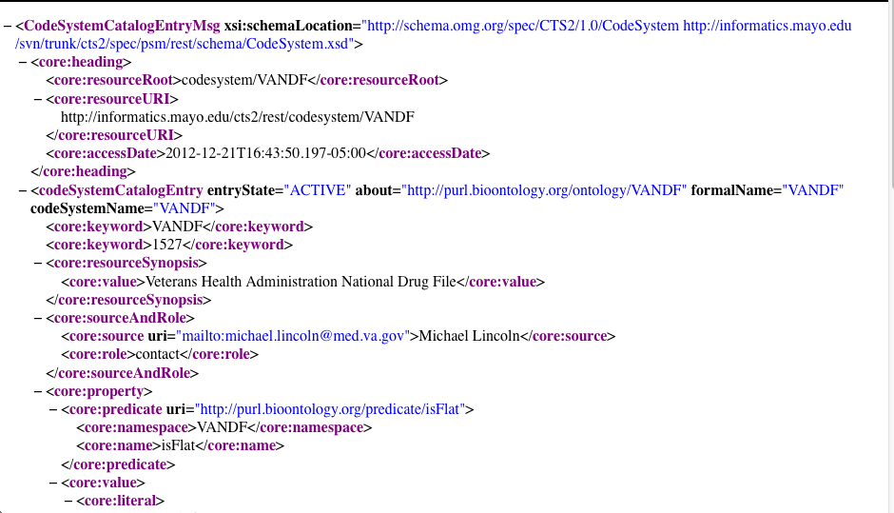

Slide 60
CTS2 REST API
A codesystemversions query has a similar query interface for getting all the versions on a given service
http://server root/codesystemversions
A more likely use case might be to get all versions of a given code system:
http://informatics.mayo.edu/cts2/rest/codesystem/LNC/versions

Slide 61
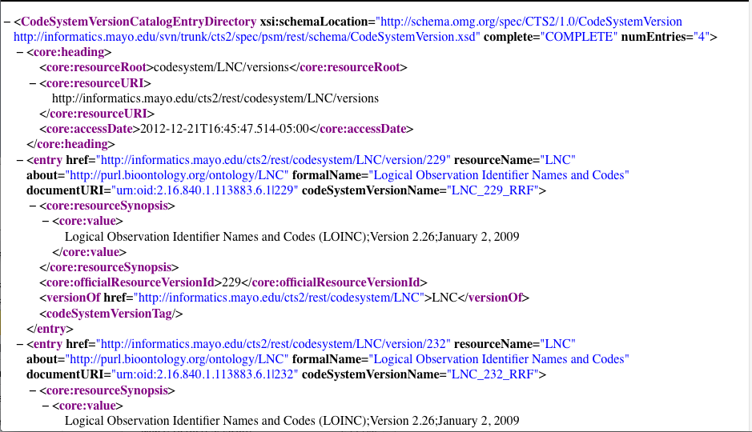

Slide 62
CTS2 REST API
Matchvalues options for codesystemversions include resourceName, about and resourceSynopsis
Perhaps more useful is to get the versions of a given code system as above, then use the href of the version designation to return the desired versionhttp://informatics.mayo.edu/cts2/rest/codesystem/LNC/version/232
This also happens to be the syntax for the code system version read function

Slide 63
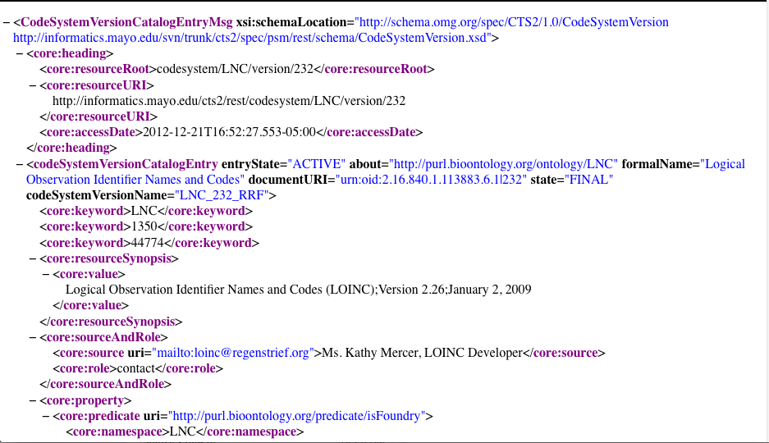

Slide 64
CTS2 REST API
Most users may simply either want to get an entity (a concept) by text match from a vocabulary service.
http://informatics.mayo.edu/cts2/rest/entities?matchvalue=swelling
Or they may want to get an entity from a particular version of a particular code system:
http://informatics.mayo.edu/cts2/rest/codesystem/LNC/version/232/entities?matchvalue=Cefoperazone

Slide 65
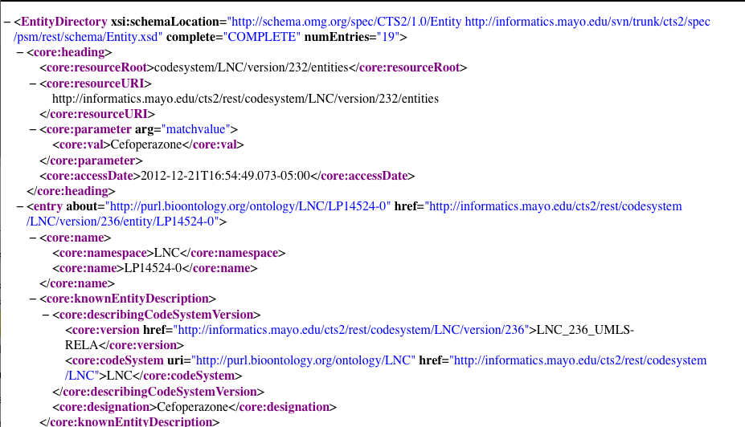

Slide 66
CTS2 REST API
Having chosen a desired entity from that list we can resolve the full entity with an entity read:
http://informatics.mayo.edu/cts2/rest/codesystem/LNC/version/232/entity/100-8

Slide 67
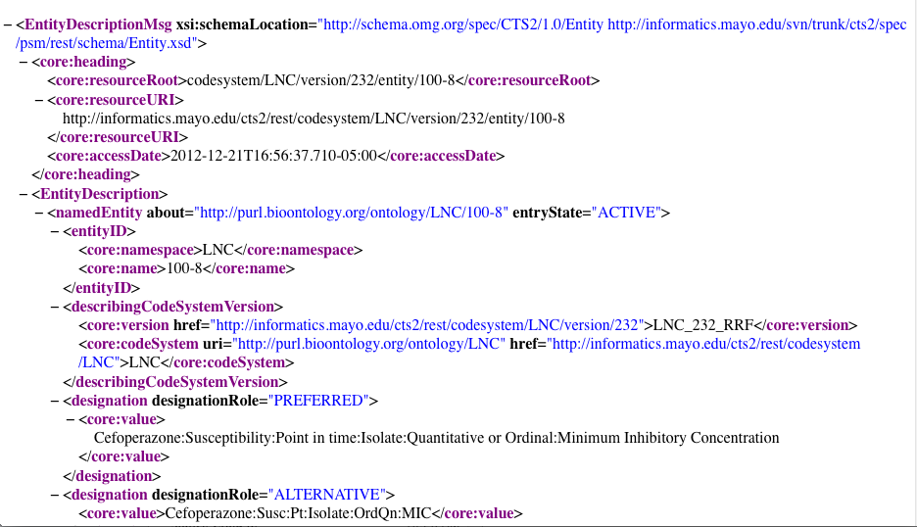

Slide 68
CTS2 REST API
This lays the foundation for a couple of likely scenarios. Starting from the code system:
Display available coding schemes to user
User chooses coding schemes
Display versions to user
User chooses code system version
Display text match for concept search
User initiates text search and makes choice from matches

Slide 69
CTS2 REST API
Alternatively:
Display text match field to user
User enters text match
Display list of entity matches
User chooses match
Display selected user friendly entity attributes and properties to user

Slide 70
CTS2 REST API
Developer Strategies:
Parse initial XML for resourceName and construct REST queries
Parse the href from each set of queries and use the resulting XML to resolve further. (Remember each result has href(s) pointing to new resource options.)

Slide 71
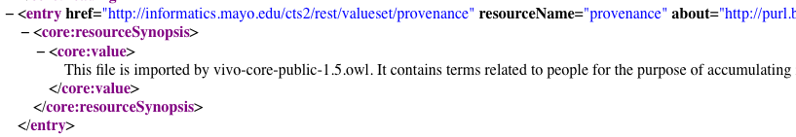
CTS2 REST API Value Sets
Using valueset and valuesets and resolvedvalueset API’s:
What value sets are on the service:
http://informatics.mayo.edu/cts2/rest/valuesets
href value can be resolved to an individual value set

Slide 72
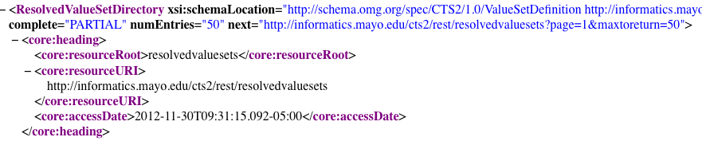
CTS2 REST API Value Sets: Pagination
Parsing values for “complete” and “next” tag will allow developers to page through results:
If complete value is “PARTIAL” then you can parse and resolve next value.

Slide 73
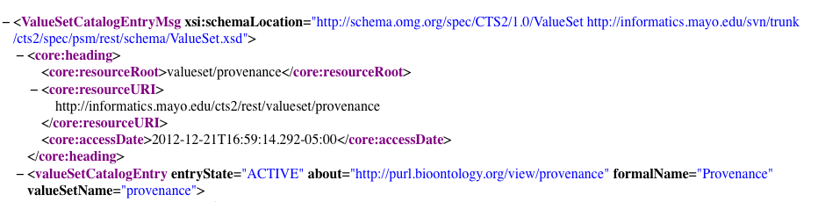
CTS2 REST API Value Sets
Getting a value set (using the href value):
http://informatics.mayo.edu/cts2/rest/valueset/provenance

Slide 74
CTS2 REST API Value Sets
Resolving a value set (adding the resolution parameter):
http://informatics.mayo.edu/cts2/rest/valueset/provenance/resolution

Slide 75
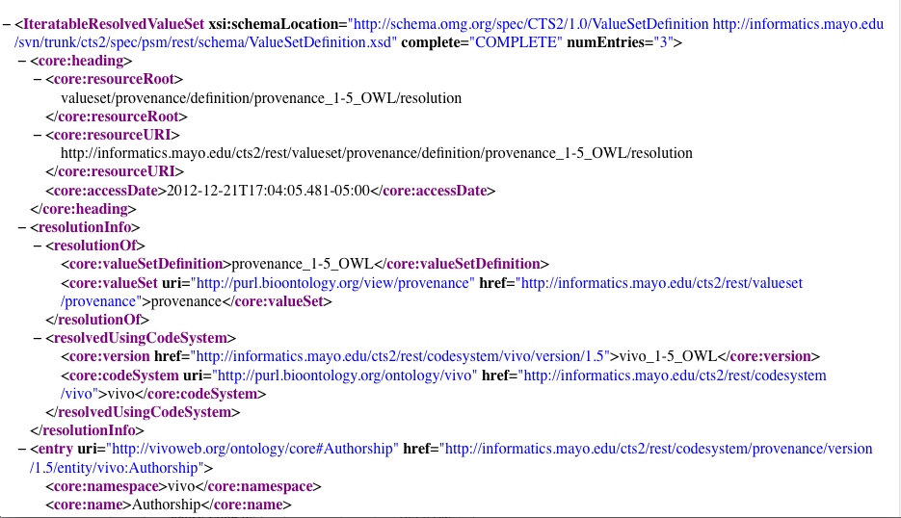

Slide 76
CTS2 REST API Value Sets
Getting the resolved value set objects:
http://informatics.mayo.edu/cts2/rest/resolvedvaluesets
Resolution using the href value from these results gives direct access to the resolved value set.
Notes:
Resolved value sets are a select set of value sets that are resolved and persisted on the service.

Slide 77
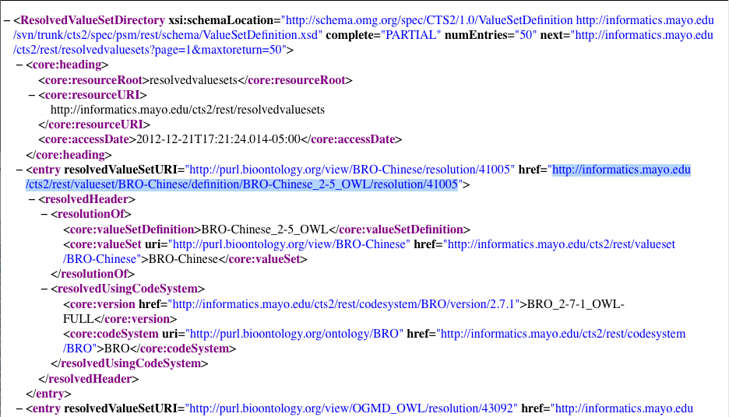
Notes:
Use the href to resolve the value set and follow through to the entity. Show in browser how to navigate through to entities.

Slide 78
CTS2 REST API Summary
Developers should now be able to text match search on CTS2 module attributes
Retrieve coding schemes, entities, and value sets
Page through large result sets
Follow href values to other module definitions as they are available

Slide 79
CTS2 Java REST Client

Slide 80
CTS2 REST Client Java
Create a new Maven project in Eclipse using cts2.rest as the group and artifact id
Check the box that allows you to make a simple Maven project (No Archetypes)
Create a class in src/main/java with a main method
(Code is found in the cts2-example-service zip ValueSetClient.java)

Slide 81
CTS2 REST Client Java
Create a method called getValueSets with a return value of void.
public void getValueSets()
You’ll need some kind of REST URL to resolve:
String uri = "http://informatics.mayo.edu/cts2/rest/valuesets";
And convert to a Java URL
URL url;
try { url = new URL(uri);

Slide 82
CTS2 REST Client Java
Create a connection:
HttpURLConnection connection = (HttpURLConnection) url.openConnection();
Test it:
if (connection.getResponseCode() != 200) { throw new RuntimeException("Failed : The HTTP error code is : " + connection.getResponseCode()); }

Slide 83
CTS2 REST Client Java
Stream it into a buffered reader:
BufferedReader br = new BufferedReader(new InputStreamReader( (connection.getInputStream())));
Here the output can be printed:
String output;
System.out.println("Output from Server .... \n"); while ((output = br.readLine()) != null) { System.out.println(output); }

Slide 84
CTS2 REST Client Java
The normal use case for XML consumption is to marshal to java objects.
Create a new method: getValueSet()
We’ll make a REST call that returns JSON and consume it using some CTS2 specific code.
String uri = "http://informatics.mayo.edu/cts2/rest/valuesets?matchvalue=Sequence&format=json";
And add a request parameter to the connection: connection.setRequestProperty("Accept", "text/json");

Slide 85
CTS2 REST Client Java
We’ll handle the buffered output differently:
JsonConverter converter = new JsonConverter();
ValueSetCatalogEntryDirectory valuesetcat = converter.fromJson(builder.toString(), ValueSetCatalogEntryDirectory.class);
Uses CTS2 Development Framework classes to handle parsing and marshaling duties

Slide 86
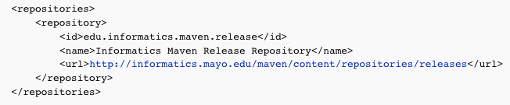
CTS2 REST Client Java
This will cause some compiling errors, so we’ll add some values to the maven project. First add a repository:
(From the CodeandPomSnippets file)

Slide 87
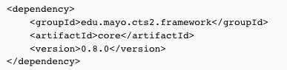
CTS2 REST Client Java
Then add a single dependency:
The CTS2 Development Framework solves a number of the parsing and marshaling problems so long as you marshal the XML or JSON into a CTS2 object.

Slide 88
CTS2 REST Client Java
Add code to print some output:
List<ValueSetCatalogEntrySummary> sum = valuesetcat.getEntryAsReference();
for(ValueSetCatalogEntrySummary s : sum){
System.out.println(s.getFormalName());
System.out.println(s.getCurrentDefinition());
System.out.println(s.getResourceName());
System.out.println(s.getValueSetName());
System.out.println(s.getHref());
}

Slide 89
CTS2 REST Client Java
And disconnect:
connection.disconnect();

Slide 90
CTS2 REST Client Java
Create a main method and run one of the methods:
public static void main(String[] args){
new ValueSetClient().getValueSet();
}

Slide 91
CTS2 REST Client Java
Simple REST clients can be duplicated in any number of implementation environments.
See details of more Java, Python, Scala and Unix based curl command implementations here:
http://informatics.mayo.edu/CTS2_V3/index.php/Value_Set_REST_API_and_Implementation_Examples

Slide 92
CTS2 Implementation Command Line and XSLT Transforms

Slide 93
CTS2 REST Client Command Line
Windows, Linux and Unix can pull in CTS2 XML via command line REST calls.
On Linux and Unix the curl command can be used to pull xml into a file where an application can process it and serve it up to a user.

Slide 94
CTS2 REST Client Command Line
For example:
curl http://informatics.mayo.edu/cts2/rest/valuesets > valuesets.xml
Pipes a CTS2 value set into an xml document where it could be served up on an eXist XML database or processed into a more user friendly file using a XSLT style sheet

Slide 95
CTS2 REST Client Command Line and XSLT
Exercise:
Use curl or a browser to get some CTS2 object in XML from a service
Use an XSLT transform to transform the values into an HTML representation.

Slide 96
CTS2 REST Client Command Line and XSLT
Using Firefox open the following in tabs:
http://informatics.mayo.edu/cts2/rest/valuesets
http://markbucayan.appspot.com/xslt/index.html
And the two XSLT files in the example folder
Use the ValueSetCatalogEntryDirectory.xsl to transform the first XML page. Use the link to click through to an IterableResolvedValueSet and try the second XSL, IterableResVS

Slide 97
CTS2 Optional Tutorial Section Python and Scala

Slide 98
Optional Tutorial Platform Independence
REST means platform independent clients
REST can be consumed by any client that can make http or https connections and parse XML or JSON
Python and Scala can both achieve this
In the example folders there is sample code for Python and Scala REST consuming clients
Note: Not an interactive demo

Slide 99
Optional Platform Independence: Python
Python, a C++ based scripting language, can create a simple REST client in a few lines of code
This example depends on a library not included in the regular Python distribution:
from restful_lib import Connection

Slide 100
Optional Platform Independence: Python
Create the connection:
conn = Connection("http://informatics.mayo.edu/cts2/rest")
reply = conn.request_get("/valuesets?format=json",
headers={'Accept':'application/json;q=1.0'})

Slide 101
Optional Platform Independence: Python
Test the response and print it:
if reply['headers']['status'] == '200':
print reply['body']
print eval(reply['body'])

Slide 102
Optional Platform Independence: Python
Here is a short, self-contained script that does a search on value sets matching the word “Sequence”:
conn = Connection("http://informatics.mayo.edu/cts2/rest")
print conn.request_get("/valuesets?matchvalue='Sequence'")['body']

Slide 103
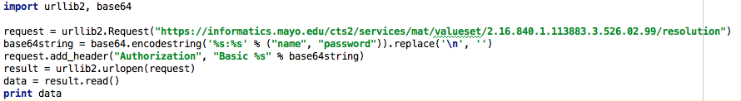
Optional Platform Independence: Python
Using a couple of integrated Python libraries you can also do authentication using https.
(Requires valid username and password)

Slide 104
Optional Platform Independence: Scala
Scala is a functional programming language that compiles to Java bytecode
As such it can reuse some of the same Java libraries used in the Java example

Slide 105
Optional Platform Independence: Scala
Import Java http and Scala input/output libraries:
import java.net.{HttpURLConnection, URL}
import io.Source
Create an executable Scala object:
object CTS2RestClient extends App{
}

Slide 106
Optional Platform Independence: Scala
Add some code to connect to the service:
val connection =
new URL("http://informatics.mayo.edu/cts2/rest/valuesets").openConnection().asInstanceOf[HttpURLConnection]

Slide 107
Optional Platform Independence: Scala
Get the input Stream:
val inputStream = connection.getInputStream
val src = Source.fromInputStream(inputStream)
Print it out:
src.getLines().foreach(println)

Slide 108
Optional Platform Independence: Next Steps
Since output can be formatted to JSON, JavaScript is an obvious example
This will be the subject of the next tutorial

Slide 109
CTS2 Development Framework Implementations, Web Applications & UI Widgets
Cory Endle

Slide 110
CTS2 Development Framework and Implementations

Slide 111
CTS2 Development Framework Implementations
There are several existing CTS2 Development Framework Implementations:
eXist database
Meaningful Use Quality Measure Value Set Service
NCBO BioPortal REST
NCBO BioPortal RDF

Slide 112
CTS2 Development Framework Implementations eXist Database
eXist XML Database Plugin:
A CTS2 implementation based on the eXist Database (an Open Source Native XML Database)
Supports:
READ
QUERY
MAINTENANCE
Notes:
Started out as a prototype and turned One of first and Mostly fully featured implementation
Cts2 functional profiles (only one to support Maintenance)

Slide 113
CTS2 Development Framework Implementations MU Quality Measure Value Set Service
A CTS2 Query implementation of Value Sets based on Meaningful Use 2 Standards for NQF eMeasures
Value Sets provided by US National Library of Medicine (NLM)
Supports:
READ
QUERY
https://informatics.mayo.edu/cts2/services/mat/valuesets
Notes:
The NLM is the Value Set Authority repository for all meaningful use eMeasures.
eMeasures are
An eMeasure (patients with diabetes or patients with hypertension) contains one or more VS containing concepts. These concepts identify the eMeasure.
We are currently mirroring the NLM VS using our eXist implementation --- and we have finished work on a new plugin to wrap their REST interfaces.

Slide 114
CTS2 Development Framework Implementations NCBO BioPortal
Component of the National Center for Biomedical Ontologies (NCBO)
Mission:
Create software and support services for the application of principled ontologies in biomedical science and clinical care, ranging from tools for application developers to software for end-users
Notes:
Repository for ontologies,
Host ontologies. Provide tools to access the content

Slide 115

CTS2 Development Framework Implementations NCBO BioPortal
Web-based application for accessing and sharing biomedical ontologies:
Search for terms
Submit a new ontology to BioPortal library
Views on large ontologies
Explore mappings between ontologies
REST based API
Many useful viewing, browsing and access widgets
Notes:
Repository for ontologies,
Host ontologies. Provide tools to access the content

Slide 116
CTS2 Development Framework Implementations NCBO BioPortal REST
NCBO BioPortal Wrapper
A CTS2 Implementation based on the NCBO BioPortal REST service
Supports:
READ
QUERY
http://informatics.mayo.edu/cts2/rest/valuesets
Notes:
Based on our experience with the eXist DB plugin, this was our next implementation into an existing datasource
Entity, codesystem, codesystem version, value sets

Slide 117
CTS2 Development Framework Implementations NCBO BioPortal RDF
RDF Triplestore Wrapper
A CTS2 implementation based on the NCBO BioPortal SPARQL endpoint
Supports:
READ
QUERY
http://informatics.mayo.edu/cts2/services/bioportal-rdf/valuesets
Notes:
NCBOs most recent implementation is RDF
Resource Description Framework (RDF)

Slide 118
CTS2 Implementations
SNOMED CT RF2 (py4cts2)
A Python implementation of CTS2 to expose the the contents of the SNOMED CT RF2 distribution
This service provides REST based access to the SNOMED CT RF2 tables and their equivalent CTS2 rendering
Supports READ and QUERY
Notes:
Implementation not using the CTS2 Framework
Did this to validate CTS2 could be implemented without the framework.

Slide 119
Web Applications using the CTS2 Service

Slide 120
Web Applications using the CTS2 Service
Now that we have an implementation of CTS2, we will want to display its content in a user friendly manner
Developed 2 different web applications that display CTS2 content
CTS2 Value Set Viewer
High-Throughput Phenotyping (HTP)

Slide 121
UIs created for CTS2 Implementations CTS2 Value Set Viewer
Generic Value Set Browser/export
Initially created for Meaningful Use (MU) Quality Measure Value Set Service to serve NLM Value Sets
Can view any CTS2 compliant Value Set service (NCBO,PHINVADS CDC,VSAC)
https://informatics.mayo.edu/vsmc

Slide 122
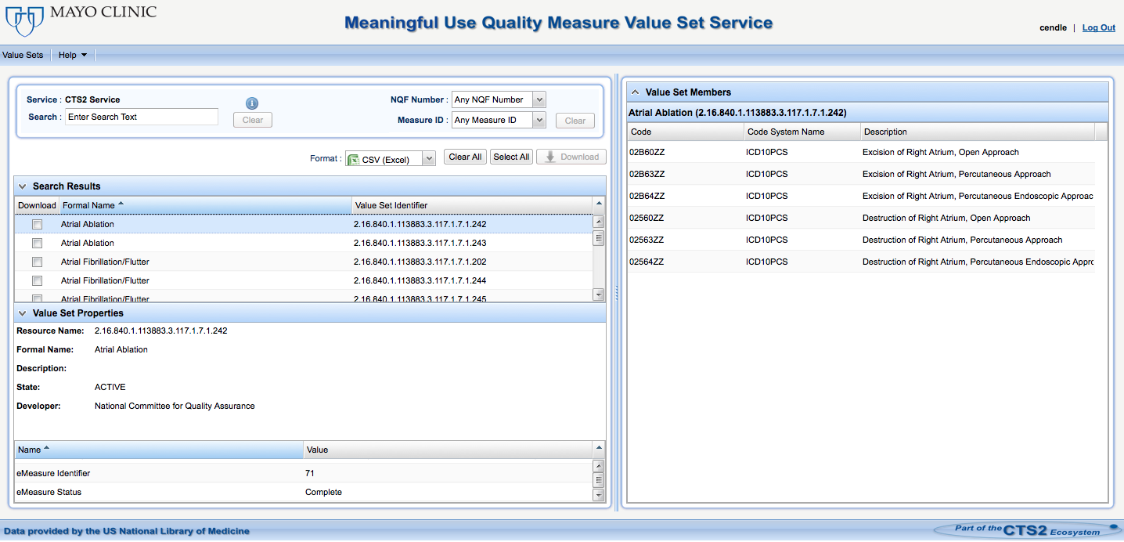
UIs created for CTS2 Implementations CTS2 Value Set Viewer
https://informatics.mayo.edu/cts2/services/mat/valuesets?&maxtoreturn=100
https://informatics.mayo.edu/cts2/services/mat/valueset/2.16.840.1.113883.3.464.0001.152/resolution
https://informatics.mayo.edu/cts2/services/mat/valueset/2.16.840.1.113883.3.464.0001.152

Slide 123
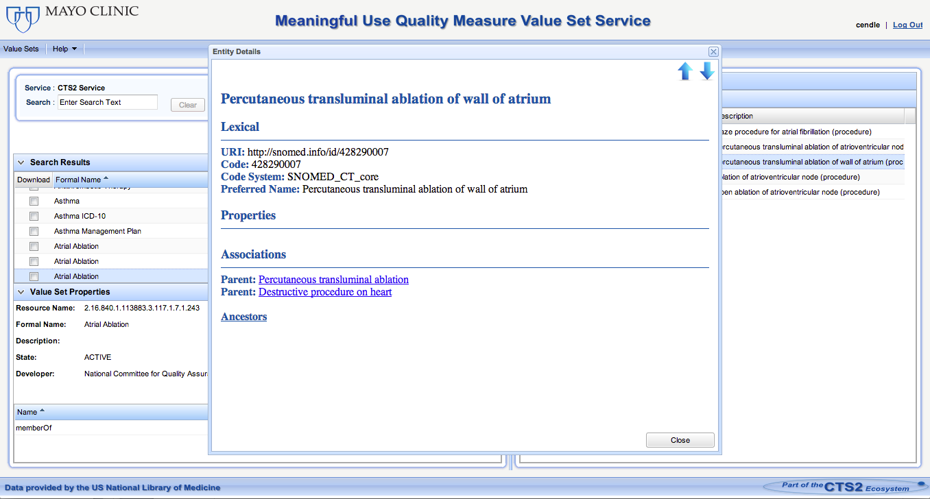
UIs created for CTS2 Implementations CTS2 Value Set Viewer
Using py4cts2 implementation to retrieve entities and their associations
Notes:
Py4cts2 implementation

Slide 124
UIs created for CTS2 Implementations High-Throughput Phenotyping (HTP) Overview
A tool to help identify patient cohorts using electronic health record (EHR) data by leveraging informatics-based phenotyping processes
Rules from the National Quality Forum (NQF) Quality Data Model (QDM) files can be uploaded to the Phenotype Portal
Notes:
We using the MU eMeasure applying against patient data to find coharts.

Slide 125
UIs created for CTS2 Implementations High-Throughput Phenotyping (HTP) Overview
Convert structured phenotype criteria into executable queries using JBoss Drools Rules
Runs against Clinical Element Model (CEM) DB and EHRs to find cohorts that match the given criteria

Slide 126
UIs created for CTS2 Implementations High-Throughput Phenotyping (HTP) Overview
Users can currently view Value Sets and their entities via the CTS2 service
Planned availability to add/remove entries from Value Sets and save them. This will allow the user to execute the phenotypes with modified criteria to see how it affects the results
Notes:
Describe the overall process of the the algorithm execution and the results.

Slide 127
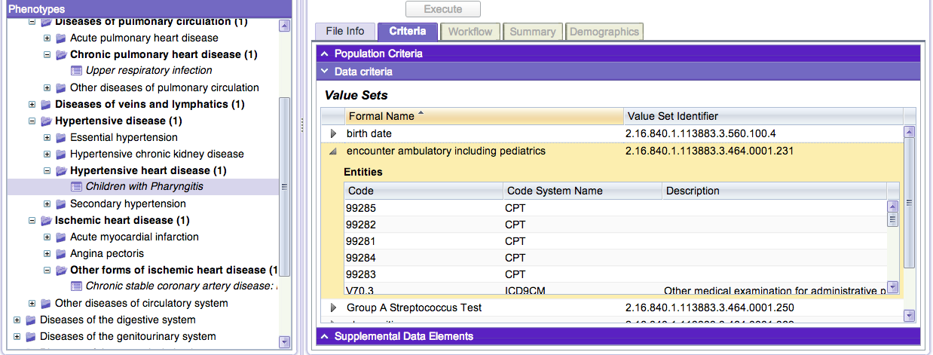
UIs created for CTS2 Implementations High-Throughput Phenotyping (HTP)

Slide 128
CTS2 Enabled UI Widgets

Slide 129
Displaying CTS2 Content
We have developed several customizable widgets that can be added to a web page to present CTS2 content
Open source and available in GitHub:
https://github.com/cts2/

Slide 130
CTS2 Enabled UI Widgets Overview
Tooltips
jQuery tooltip widget used to display value sets and code systems when you mouse over text
Autocomplete
jQuery autocomplete widget used to suggest value sets as you type
Dropdown
jQuery example to fill a select (dropdown) with specific resolved value sets

Slide 131
CTS2 Enabled UI Widgets Demonstration
http://informatics.mayo.edu/cts2widgets/widgets.html
Features and customization points of each widget:
Ability to set the value set ID/code system ID to retrieve different values
Cascading Style Sheets (CSS) to change the look and feel
CTS2 parameterized values to customize the query
Notes:
Go to http://informatics.mayo.edu/cts2widgets/widgets.html

Slide 132
UI Widget: Tooltip

Slide 133
CTS2 Enabled UI Widgets Lab Exercise - Tooltip
Retrieve a list of available value sets:
http://informatics.mayo.edu/cts2/rest/valuesets
Select any value set – resourceName
Example: skos

Slide 134
CTS2 Enabled UI Widgets Lab Exercise - Tooltip
Look at the result of value set call:
http://informatics.mayo.edu/cts2/rest/valueset/skos
We will use the data returned here to populate our CTS2 tooltip widget

Slide 135
CTS2 Enabled UI Widgets Lab Exercise – Tooltip in JSFiddle
We will use JSFiddle to work with the web related files
JSFiddle allows us to see all the files (CSS, JavaScript, and HTML) in one page and edit them
Changes are seen immediately
http://jsfiddle.net/coryendle/n9bWF/

Slide 136
CTS2 Enabled UI Widgets Lab Exercise – Tooltip: Add new Tooltip
Create a new tooltip for your value set ID
Add the HTML to display the tooltip with your value set ID
<p><a href="#" class="hint_vs" data-id="skos">SKOS</a> Value Set Demo.</p>
Select the “Run” button to test your changes.

Slide 137
CTS2 Enabled UI Widgets Lab Exercise – Tooltip: Change Attributes
Update the Tooltip fadeIn/fadeOut speed
“slow”
“fast”
Milliseconds
Find the following JavaScript function:
function showTooltipValueSets()
Replace the fadeIn("slow") to fadeIn("slow") This will make the tooltip appear over a 2 second duration

Slide 138
CTS2 Enabled UI Widgets Lab Exercise – Tooltip: Add a row to the tooltip
Update the tooltip to display another row of data. We will add the entryState status:
Find the following function:
function getValueSetTableInfo(valueSetJson)
Add another variable:
var entryState = valueSetJson.valueSetCatalogEntryMsg.valueSetCatalogEntry.entryState;

Slide 139
CTS2 Enabled UI Widgets Lab Exercise – Tooltip: Add a row to the tooltip
Add another HTML row:
"<tr><td class=\"noWrap\">Entry State:</td><td>" + entryState + "</td></tr>" +
Select the “Run” button to test your changes

Slide 140
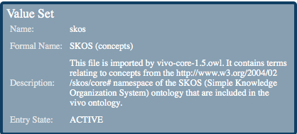
CTS2 Enabled UI Widgets Lab Exercise – Tooltip: Add a row to the tooltip
Now when you mouse over a value set ID, you will see an additional row called “Entry State” in the tooltip

Slide 141
CTS2 Enabled UI Widgets Lab Exercise – Tooltip: Change the Background Color
We will update the CSS to change the background color
In the CSS file, find the following section:
div#tooltip
Replace this line:
background-color: #879fb1;
With this:
background-color: #f49956;

Slide 142
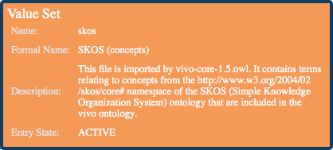
CTS2 Enabled UI Widgets Lab Exercise – Tooltip: Change the Background Color
Select the “Run” button to test your changes
Now when you mouse over a value set ID, you will see the background of the Tooltip has changed

Slide 143
UI Widget: Dropdown

Slide 144
CTS2 Enabled UI Widgets Lab Exercise – Dropdown: Country of Birth
We will create a dropdown to select a person’s country of birth
Retrieve a list of available value sets from CDC PHINVADS CTS2 service:
http://informatics.mayo.edu/cts2/services/phinvads/valuesets?maxtoreturn=100
Select the value set where:
valueSetName=“PHVS_BirthCountry_CDC”
Notes:
Center for Disease Control (CDC)
Public Health Information Network Vocabulary Access and Distribution System (PHINVADS)
http://www.cdc.gov/phin/tools/PHINvads/index.html

Slide 145
CTS2 Enabled UI Widgets Lab Exercise – Dropdown: Country of Birth
Look at the result of resolved value set call:
http://informatics.mayo.edu/cts2/services/phinvads/valueset/PHVS_BirthCountry_CDC/resolution
We will use the data returned here to populate our CTS2 dropdown widget

Slide 146
CTS2 Enabled UI Widgets Lab Exercise – Dropdown: Country of Birth
JSFiddle code:
http://jsfiddle.net/coryendle/bhTaD/
In the HTML code, we will add another dropdown to select the country of birth
After the code for the “Severity” dropdown, add the following line of code:
<br/><br/> Country of Birth: <select class="cts2-valueset(name : PHVS_BirthCountry_CDC;max:500)"></select>

Slide 147

CTS2 Enabled UI Widgets Lab Exercise – Dropdown: Country of Birth
Select the “Run” button to test your changes
You will now see the Country of Birth dropdown:

Slide 148
Summary

Slide 149
UI and Widget Review
Examples of Web Applications that utilized CTS2 Service
Customizable UI widgets available to quickly see the CTS2 content
Open Source

Slide 150
References
Sample REST calls for Module Specifications:
http://www.bioontology.org/wiki/index.php/CTS2_BioPortal_wrapper_summary
Sample REST calls for Module Specifications against an RDF triple store:
http://www.bioontology.org/wiki/index.php/CTS2_RDF_Plugin
REST interfaces for CTS2:
http://informatics.mayo.edu/cts2/index.php/REST
Service Plugin resources:
https://github.com/hsbauer/cts2-example-service/archive/master.zip
http://informatics.mayo.edu/cts2/framework/downloads/cts2framework-standalone.jar
http://www.mysql.com/downloads/mysql/5.1.html
http://maven.apache.org/download.html (Maven 2.2.1)
http://www.eclipse.org/downloads/

Slide 151
References
BioPortal REST Wrapper
http://informatics.mayo.edu/cts2/rest/valuesets
BioPortal RDF Wrapper
http://informatics.mayo.edu/cts2/services/bioportal-rdf/valuesets
BioPortal SPARQL endpoint:
http://sparql.bioontology.org/
MU Quality Measure Value Set Service
https://informatics.mayo.edu/cts2/services/mat/valuesets
GUIs that display CTS2 Content:
https://informatics.mayo.edu/vsmc
http://www.phenotypeportal.org/
UI Widgets Example:
http://informatics.mayo.edu/cts2widgets/widgets.html

Slide 152
References
UI Widgets in GitHub:
https://github.com/cts2/
https://github.com/cts2/cts2autocomplete
https://github.com/cts2/cts2tooltip
https://github.com/cts2/cts2dropdown
jQuery UI Widget Reference:
http://jqueryui.com/
JSFiddle UI Widgets Lab Exercises:
Tooltip: http://jsfiddle.net/coryendle/n9bWF/
Autocomplete: http://jsfiddle.net/coryendle/dKjXs/
Dropdown: http://jsfiddle.net/coryendle/bhTaD/

Slide 153
Questions & Discussion

